Slide 1
Image Recognition Application Using Cloud-Based Machine Learning Services
Presenter Name :
M Lakshmi Narayana Reddy[192224110]
Faculty:
N Madhusundar

Slide 2
ABSTRACT:
Cloud-powered Vision: Unleash powerful image analysis with cloud-based ML. Faster, more accurate results without beefy hardware.
Effortless Image Recognition: Pre-trained models and APIs simplify development. Focus on your app, the cloud handles complex image recognition.
Scalable & Cost-Effective: Cloud adapts to your needs. Pay-as-you-go and benefit from continuous advancements.

Slide 3
INTRODUCTION:
Images are brimming with data, but extracting it requires powerful tools.
This presentation explores how cloud-based machine learning unlocks image insights through:
Cloud-powered Vision: Leverage the cloud's processing muscle for faster, more accurate image analysis.
Effortless Image Recognition: Pre-trained models and APIs streamline development, letting you focus on your application.
Scalable & Cost-Effective: Pay-as-you-go and benefit from continuous advancements in the cloud.

Slide 4
OBJECTIVES:
Demystify cloud-based image recognition: Explore how cloud ML services analyse images.
Highlight cloud's advantages: Focus on scalability, cost-efficiency, and development ease.
Showcase real-world applications: Briefly explore use cases across various fields.
Empower developers: Provide actionable insights for building intelligent image recognition apps.

Slide 5
Existing Systems:
Medical Diagnosis: Doctors upload X-rays to the cloud for analysis, aiding faster and more accurate diagnoses. (e.g., Google Cloud Vision AI)
Retail: Customers upload pictures of items, and the cloud recommends similar products (e.g., Amazon Recognition). Studies show a 30% increase in online sales. (e.g., McKinsey & Company)
Self-Driving Cars: Cloud services analyse video feeds from car cameras, identifying objects for safe navigation. (e.g., Microsoft Azure Cognitive Services)

Slide 6
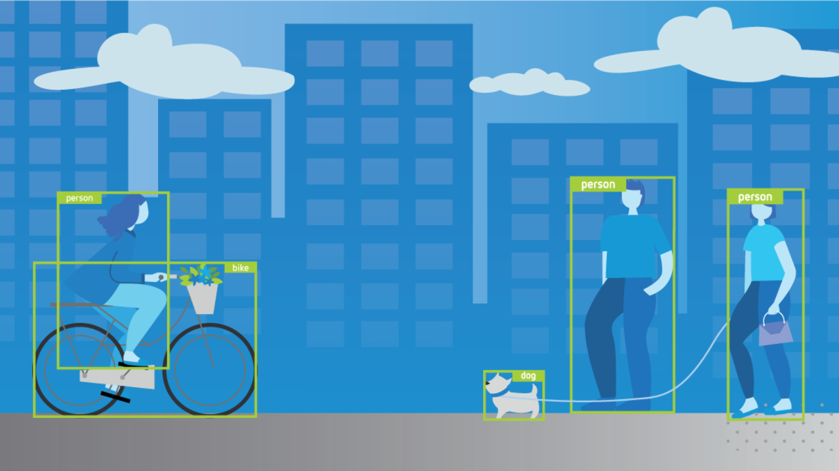
ADVANTAGES:
Cloud Powerhouse: Leverage Scalable Processing for Powerful Image Analysis
Effortless Development: Pre-built Tools for Faster Time-to-Market
DISADVANTAGES:
Data Reliance: Security and Privacy Considerations for Sensitive Data
Network Dependence: Potential Latency Issues for Real-Time Applications

Slide 7
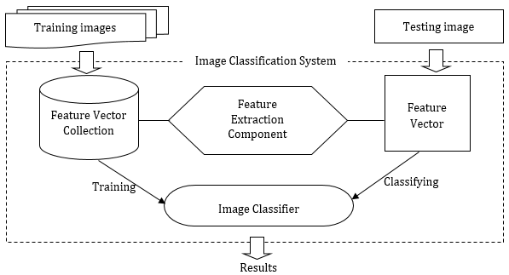
Architecture Diagram

Slide 8
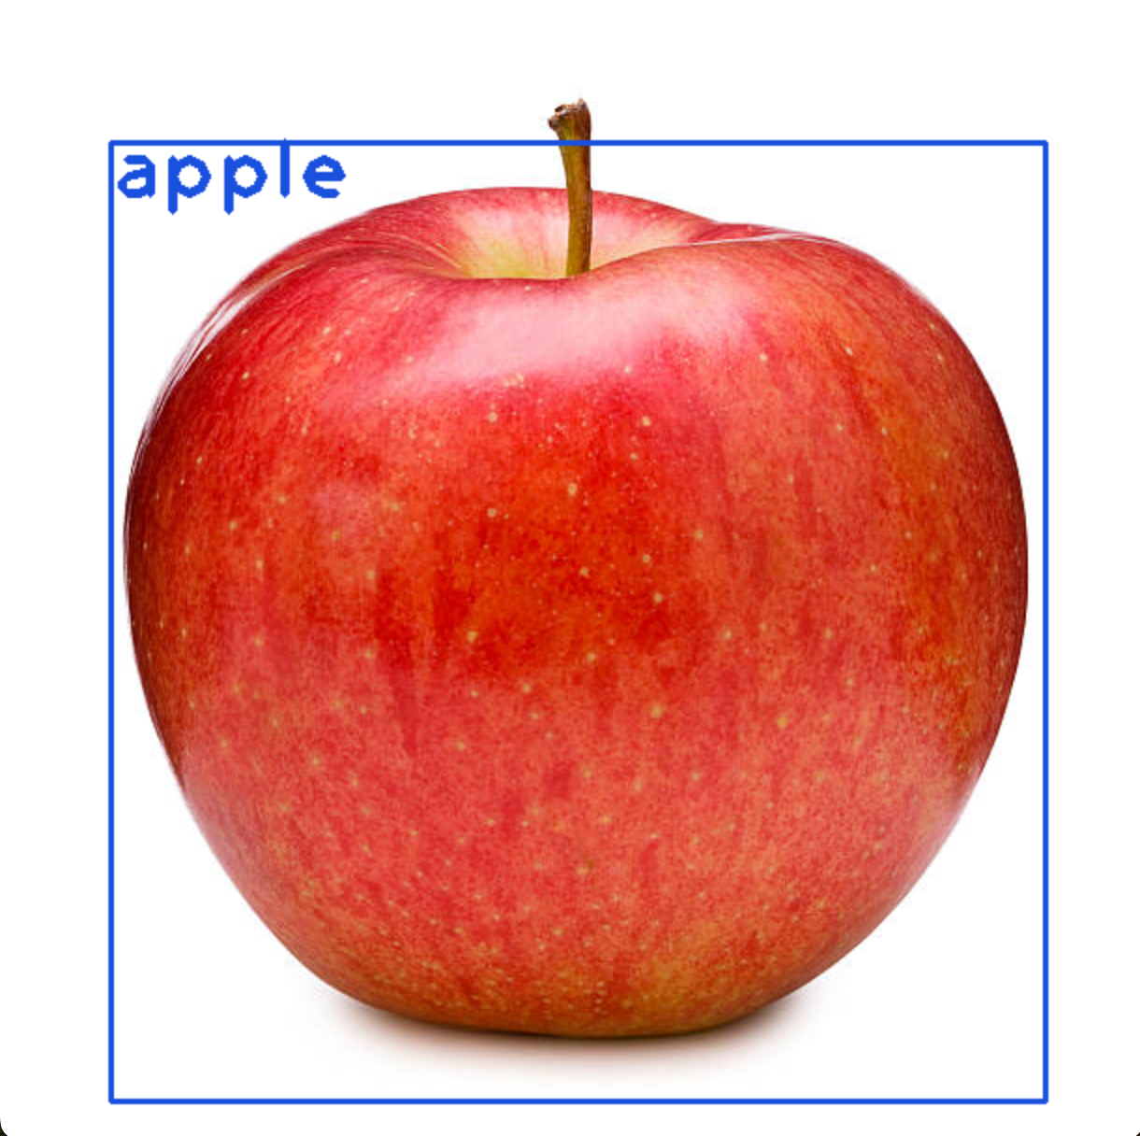
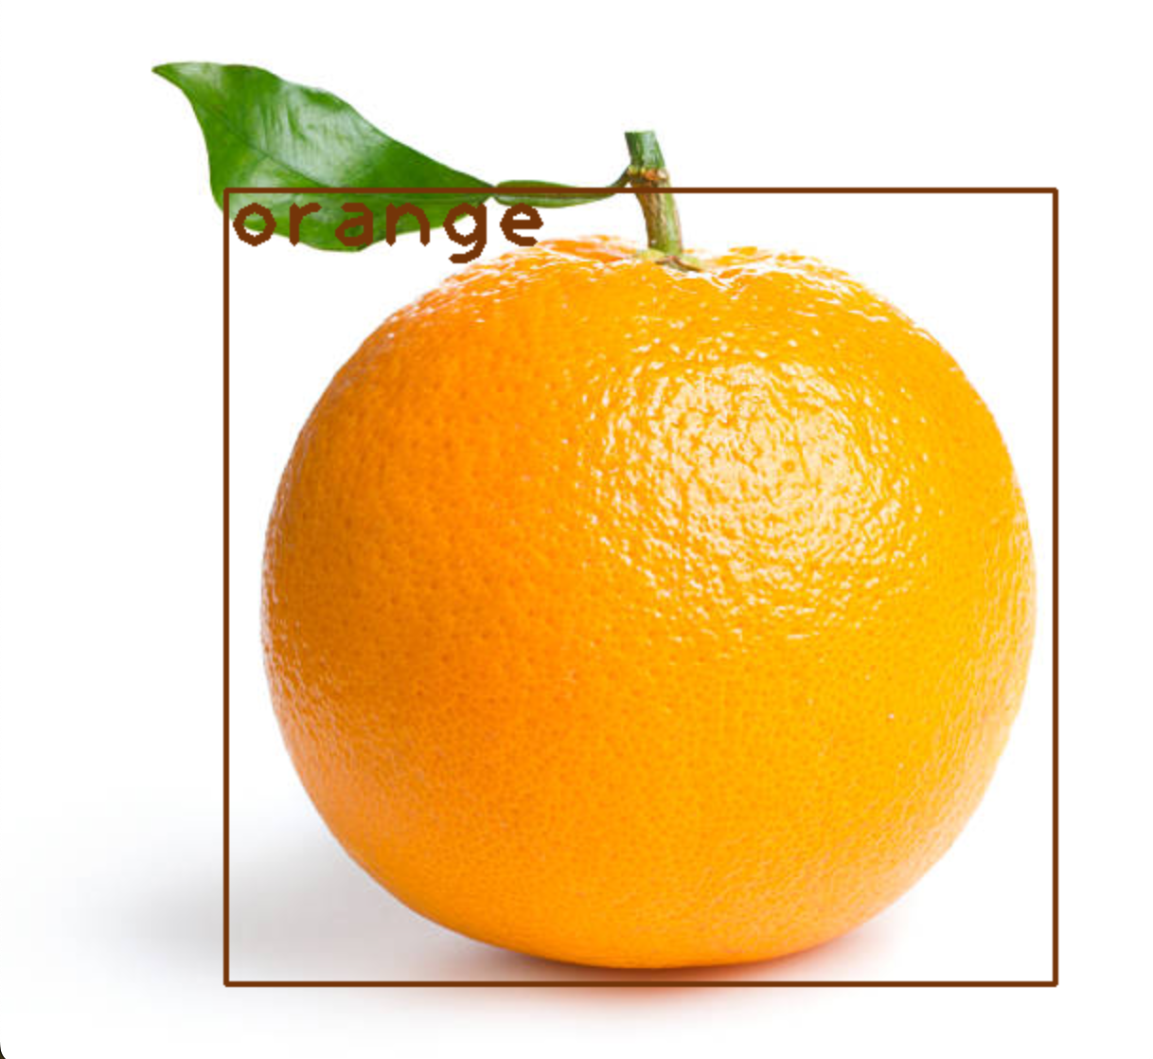
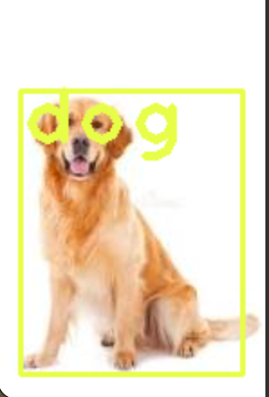
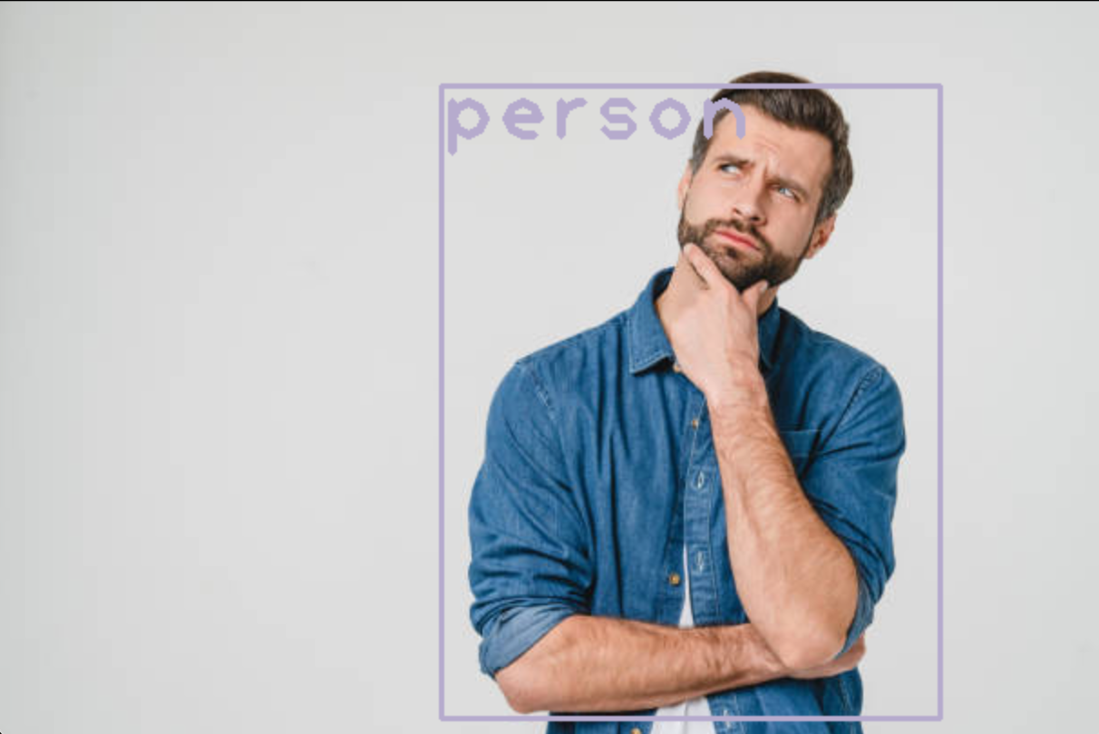
OUTCOMES OF
THIS
PROJECT:

Slide 9
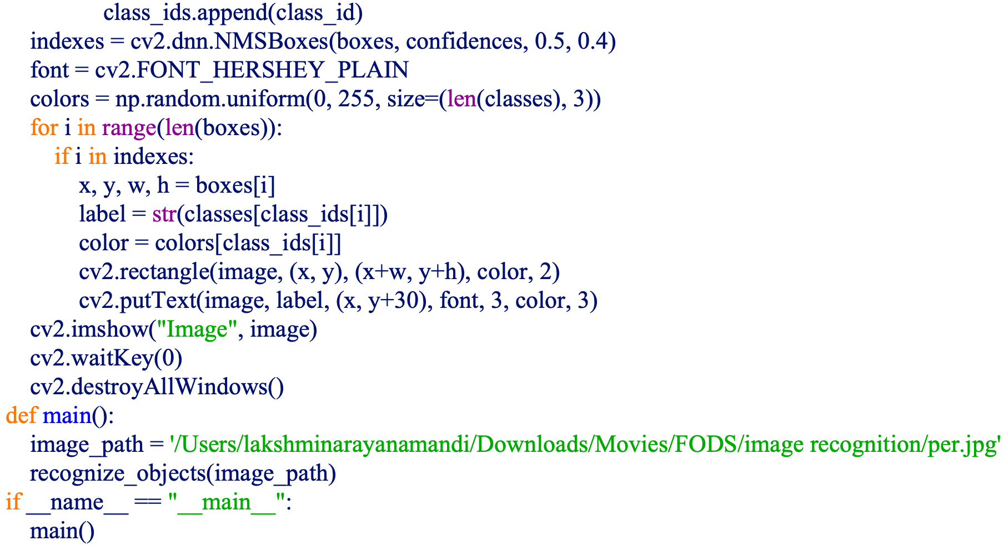
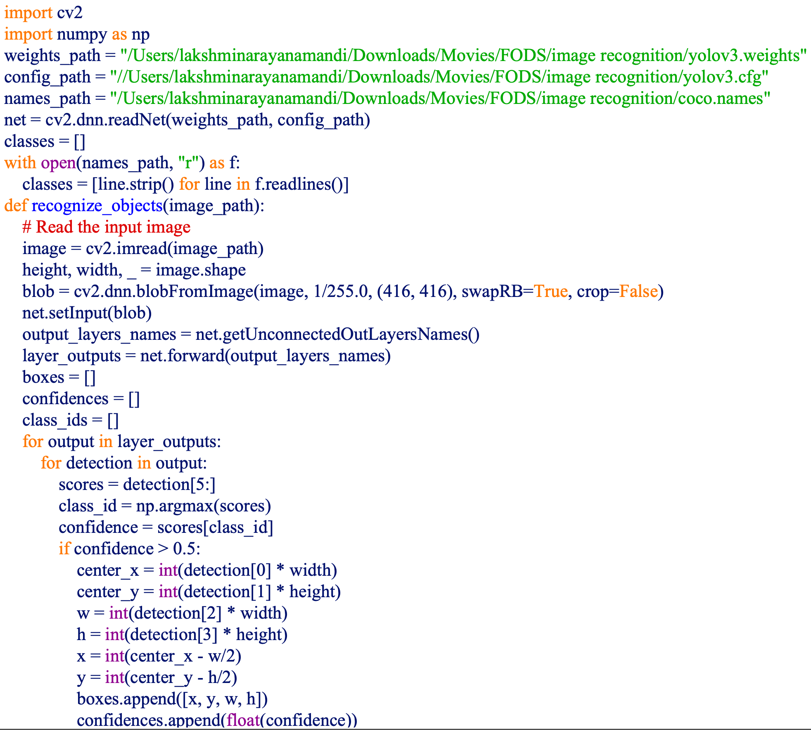
IMPLEMENTATION

Slide 10
Conclusion:
This project explored how cloud-based machine learning empowers image recognition. We discovered the cloud's:
Unmatched Processing: Cloud muscle tackles complex image analysis, exceeding local device capabilities.
Simplified Development: Pre-built tools streamline development, letting developers focus on their applications.
Scalability & Affordability: Cloud services adapt and scale with your needs, offering a pay-as-you-go model.

Slide 11
REFERENECES:
L. M. Dang, M. J. Piran, D. Han, K. Min, and H. Moon, “A survey on internet of things and cloud computing for healthcare,” Electronics, vol. 8, no. 7, p. 768, 2019.
R. K. Barik, H. Dubey, C. Misra et al., “Fog assisted cloud computing in era of big data and internet-of-things: systems, architectures, and applications,” Cloud Computing for Optimization, Springer, Berlin, Germany, 2018.
G. Aceto, V. Persico, and A. Pescapé, “Industry 4.0 and health: internet of things, big data, and cloud computing for healthcare 4.0,” Journal of Industrial Information Integration, vol. 18, Article ID 100129, 2020.
G. Manogaran, R. Varatharajan, D. Lopez, P. M. Kumar, R. Sundarasekar, and C. Thota, “A new architecture of internet of things and big data ecosystem for secured smart healthcare monitoring and alerting system,” Future Generation Computer Systems, vol. 82, pp. 375–387, 2018.
W. Wang, N. Kumar, J. Chen et al., “Realizing the potential of internet of things for smart tourism with 5G and AI,” IEEE Network, vol. 34, no. 6, pp. 295–301, 2020.

Slide 12


